Slide 1
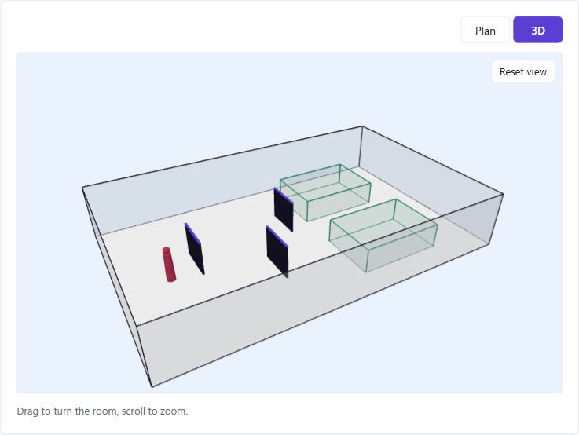

Allquiet
Powered by Quanscient Allsolve
A quieter workplace is a healthier one. Physics shows where the panels go.
Veli Lampila · Santeri Hukari · Arman Borujerdi
Notes:
Open with the human point, not the software. Allquiet is a small app on top of Quanscient Allsolve: it tells an office where to put a handful of acoustic panels so the people who need quiet actually get it. The picture is the app's own 3D view of the demo result.

Slide 2
Among environmental causes of ill health in Europe, noise is second only to air pollution.
NOISE IS A HEALTH ISSUE
Traffic noise alone costs western Europe more than 1 million healthy life-years every year. Then we go to work and sit in a shared room for eight hours.
Source: WHO Regional Office for Europe, Burden of disease from environmental noise, 2011
Notes:
Noise is usually treated as a comfort problem. The WHO treats it as a disease burden: annoyance, disturbed sleep, heart disease. These figures are about environmental noise such as traffic, not offices, so say that plainly. The bridge is that the working day is where many people get their longest continuous exposure to other people's noise. The next slide is the office evidence.

Slide 3
What office noise does to people
THE EVIDENCE
+34%
+25%
−40%
sweat response, a physical sign of stress, after 8 minutes of open-plan noise
negative mood in the same experiment
attempts at a hard puzzle after 3 hours of low-level office noise, with raised adrenaline
Sander et al., 2021
Sander et al., 2021
Evans & Johnson, 2000
In a survey of more than 42,000 office workers, noise and lost sound privacy outweighed the benefit of easier interaction in open-plan offices.
Sources: J. Management & Organization 2021 · J. Applied Psychology 2000 · Kim & de Dear, J. Environmental Psychology 2013
Notes:
Three findings, two experiments. Sander and colleagues at Bond University put volunteers in simulated open-plan noise for eight minutes: sweat response up 34 percent, negative mood up 25 percent. Evans and Johnson at Cornell gave 40 clerical workers three hours of low-level office noise: higher adrenaline, 40 percent fewer attempts at a hard puzzle, and half as many posture adjustments at the desk. Kim and de Dear's survey covers 303 buildings. These are short lab exposures; real people get this all day.

Slide 4
Offices buy acoustic panels, then place them by eye.
THE GAP
If you can afford only three panels, where do they protect the most people?
A rule of thumb gives a direction. Nobody gets a position, or a number for what the second and third panel are worth.
Notes:
The treatment exists: screens, dividers, panels. The decision is the weak spot. Facilities teams put the panels where they look sensible and hope. Our question is narrow on purpose: a fixed number of panels, and the position for each that helps the people who need quiet.

Slide 5
Speech is as big as the furniture
WHY IT IS HARD
Speech in air
Things in an office
Frequency | Wavelength
250 Hz | 1.37 m
500 Hz | 0.69 m
1 kHz | 0.34 m
2 kHz | 0.17 m
Object | Size
Acoustic screen | 1.2–2.6 m
Desk | 1.6 m
Gap, screen to wall | 1–2 m
Sound does not stop at a screen. It bends around the ends, and the bent waves interfere. Formulas and ray tracing are weakest exactly here, so the room has to be solved as a wave problem.
Notes:
This is the technical heart, kept short. Speech sits between 250 hertz and 2 kilohertz, so its wavelengths run from 17 centimetres to well over a metre: the same size as a screen, a desk, the gap to the wall. At that scale sound diffracts. Barrier formulas handle one screen in open space; ray tracing assumes the wavelength is tiny. A finite-element solve of the wave equation needs neither assumption.

Slide 6
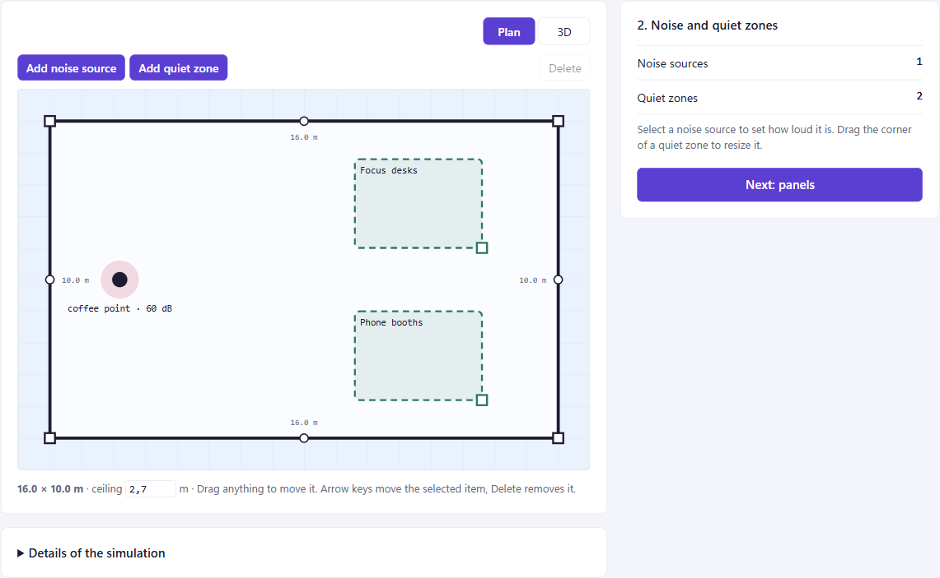
From a room to a placement
THE PRODUCT
1 Bring the room
Scan it with a phone and trace the walls, or draw the outline.
2 Mark noise and quiet
Where people talk, and where people need to concentrate.
3 Say how many panels
One to four, with a quick or a detailed search.
4 Get the positions
Allsolve simulates the layouts. Each panel comes back measured from the walls.
Notes:
No acoustics knowledge needed to use it. Four steps: the room, the noise and the quiet zones, the number of panels, the answer. The screenshot is step two in the demo office: a coffee point on the left, focus desks and phone booths on the right. A phone scan can be opened under the plan and traced.

Slide 7
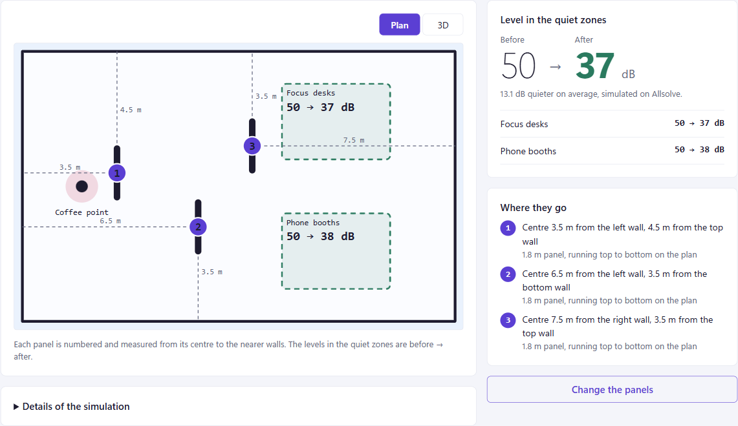
Three panels, placed by simulation
THE DEMO
50 → 37
dB in the quiet zones, before and after: 13 dB quieter on average
22 layouts and 44 wave solves on Allsolve in 33 seconds
The in-browser rule of thumb scored this layout 78. Allsolve scored it 24, where 100 is the room with no panels.
Simulated levels for this model of the room. They compare layouts and are not a certified measurement.
Notes:
This is a real run from today, not a mock-up: the demo office, one coffee point at 60 dB, two quiet zones, three panels, the quick search. Allsolve solved 22 layouts at two speech bands in 33 seconds and the quiet zones dropped from 50 to about 37 dB in the model. Point at the gap between the rule of thumb and the wave solve: the formula badly underrates this layout, which is exactly why we do not trust it for the decision. Say the caveat out loud: this ranks layouts, it is not a measured reduction.

Slide 8
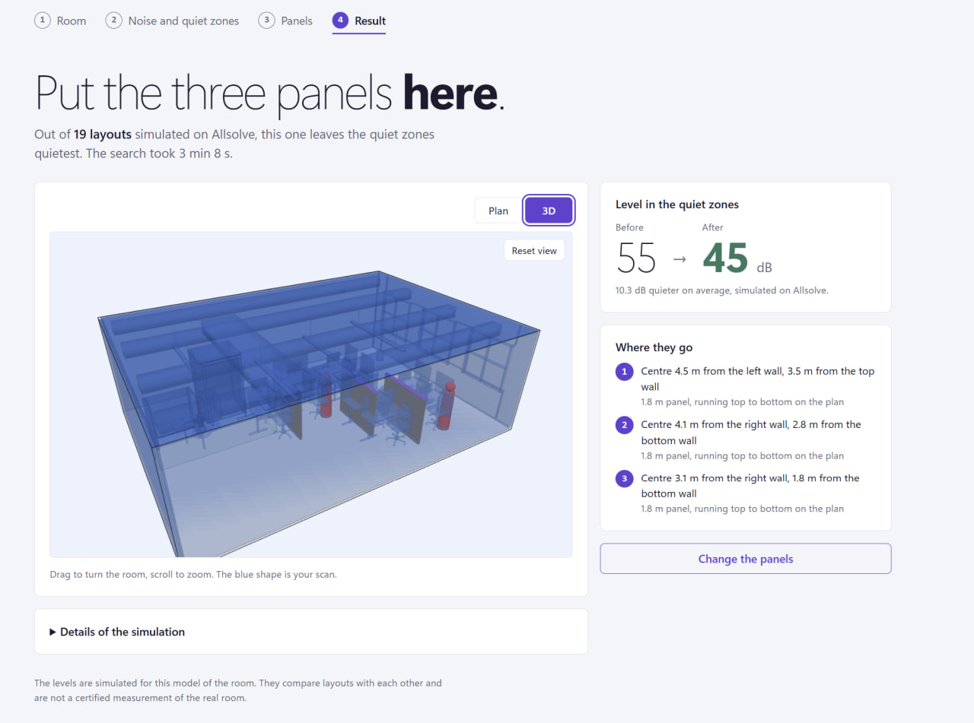
An office scanned with a phone
A REAL ROOM
55 → 45
dB in the quiet zones, before and after three panels: 10 dB quieter on average
A 10.6 × 7.3 m office, traced over its own scan. 19 layouts on the detailed search in 3 min 8 s.
The blue shape is the scan. The panels come back as distances from the walls, ready for whoever carries them in.
Simulated levels for this model of the room. They compare layouts and are not a certified measurement.
Notes:
The demo office is a drawing. This one is a real room: scanned with a phone, opened in the app, walls traced on top of the scan. Three panels, the detailed search, a little over three minutes on Allsolve. The quiet zones go from 55 to 45 dB in the model. The answer is practical: each panel is given as a distance from two walls.

Slide 9
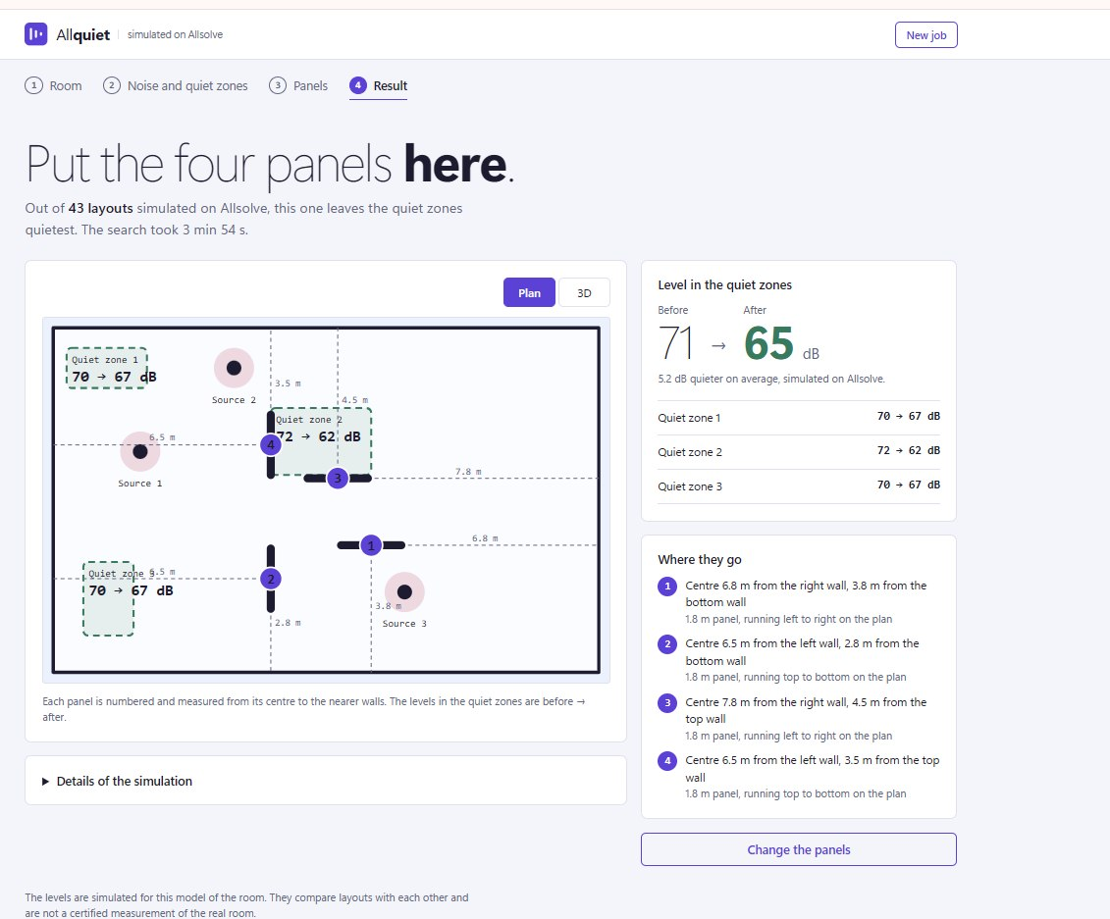
Three noise sources, three places to protect
A HARDER ROOM
72 → 62
dB in the worst quiet zone. The other two go from 70 to 67 dB.
Four panels, 43 layouts simulated in 3 min 54 s.
With noise from three sides, no guess puts four panels well. The search spends them where the people sit closest to the noise, and shows what each zone gains.
Simulated levels for this model of the room. They compare layouts and are not a certified measurement.
Notes:
This is where guessing breaks down. Three sources, three quiet zones, four panels. The search tried 43 layouts. Be honest about the outcome: the zone in the middle gains 10 dB, the two in the corners gain 3. Four panels cannot fix everything in a loud room, and the app says so per zone, which is what a facilities manager needs before buying more.

Slide 10
A search needs hundreds of solves
POWERED BY ALLSOLVE
100
28 s
24 s
cloud machines can run one sweep at the same time
for 360 layouts: 720 wave solves over two speech bands
for 803 layouts when the room's meshes are used again
Panel positions are project variables in the Allsolve Python SDK. One project describes every layout, and the pressures at each listening point come back as numbers in Python.
Timings measured in this project on the 2D model of a 16 × 10 m office
Notes:
Why Allsolve is not a detail. One simulation tells you how loud it is with the panels here. The user asks where here should be, and that is hundreds of solves on changing geometry. The SDK gives us geometry as variables, sweeps that run in parallel in the cloud, and results back in the same Python process that serves the web app. No solver to install, no workstation. Without scripted access to geometry, meshing, solving and results there is no product.

Slide 11
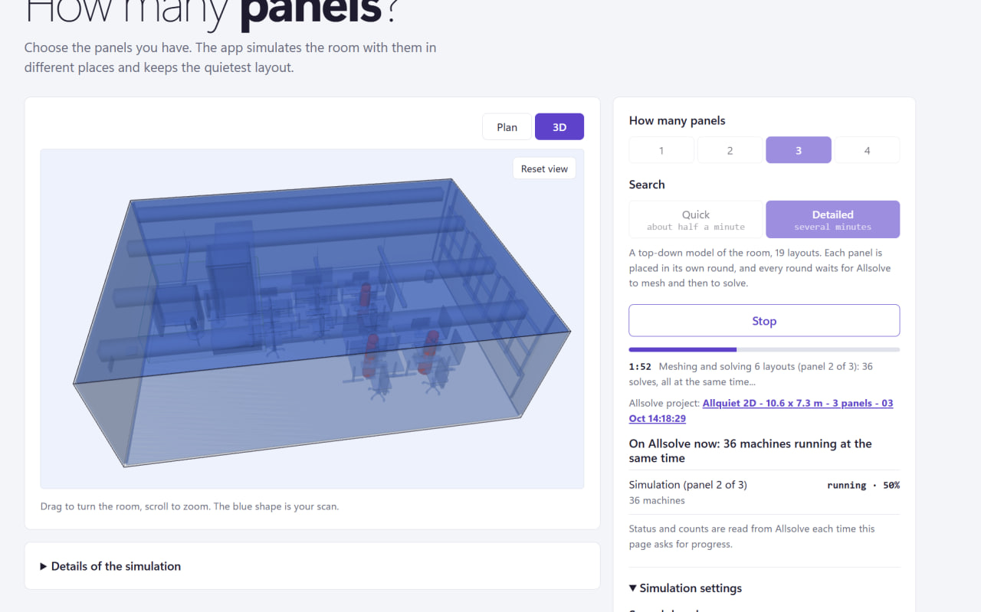
One click, 36 machines in the cloud
WHILE IT RUNS
36
Allsolve machines solving one round of layouts at the same time
The app reads status and counts from Allsolve and links to the project, so every number can be traced.
Notes:
This is the scanned office mid-search. The user pressed one button. Behind it the backend placed panel two of three, sent six layouts as 36 solves, and Allsolve is running them on 36 machines at once. The laptop only orchestrates. The link opens the project in Allsolve, and the app keeps a record of every request and answer.

Slide 12
Why not a simpler tool
THE ALTERNATIVES
Approach | Good at | Where it falls short for placement
Rules of thumb | Rating an existing office | They describe a result and cannot predict a layout
Barrier formulas | Instant, runs in a browser | One screen in open space: no interference, no room
Ray tracing | Large rooms, high frequencies | Weak at bending around screens one wavelength wide
Desktop FEM | The same wave physics | A licence and workstation per user, hard to script 200 runs
Allsolve + SDK | Wave physics in the cloud | Minutes, not milliseconds: we show an estimate first
Notes:
Expect this question from the jury. Each simpler tool is good at something, and each misses one of our two needs: real wave physics, and a solver you can drive from code hundreds of times. Allsolve with the SDK is the one option that does both. Its cost is latency, which is why the app shows a quick estimate first and replaces it with the simulation.

Slide 13
Honest limits, clear next steps
WHERE WE ARE
What the number means today
What comes next
It ranks layouts in a simplified model. It is not a certified dB reduction.
It covers the low and middle speech bands, where bending decides the outcome.
The full 3D room works and costs more: two layouts took about five minutes.
Show the solver's own pressure field as the sound map.
Absorbing panels and wall materials, not only blocking ones.
Real floor plans through CAD import.
A budget in euros in place of a panel count.
Notes:
Being straight about the limits is part of the argument. The result compares layouts inside a model; it has not been calibrated against a measured room. Full 3D at high frequency is too large for finite elements, and that is fine, because screens are hardest to place at the low and middle bands. Every next step is a feature Allsolve already has, so it is an edit to our project builder, not a new toolchain.

Slide 14

Quiet is a health measure.
Allquiet puts acoustic treatment where physics says it matters. Simulated on Quanscient Allsolve.
Veli Lampila · Santeri Hukari · Arman Borujerdi
Notes:
Close on the people, not the solver. Offices already spend money on quiet; we make that money land where it protects the most people, and we can show the physics behind every position. Then offer the live demo.

